Slide 1


12th International Young Scientists Conference on Computational Science
CIS Multilingual License Plate Detection and Recognition Based on Convolutional and Transformer Neural Networks
Irek Saitov and Andrey Filchenkov
ITMO university

Slide 2


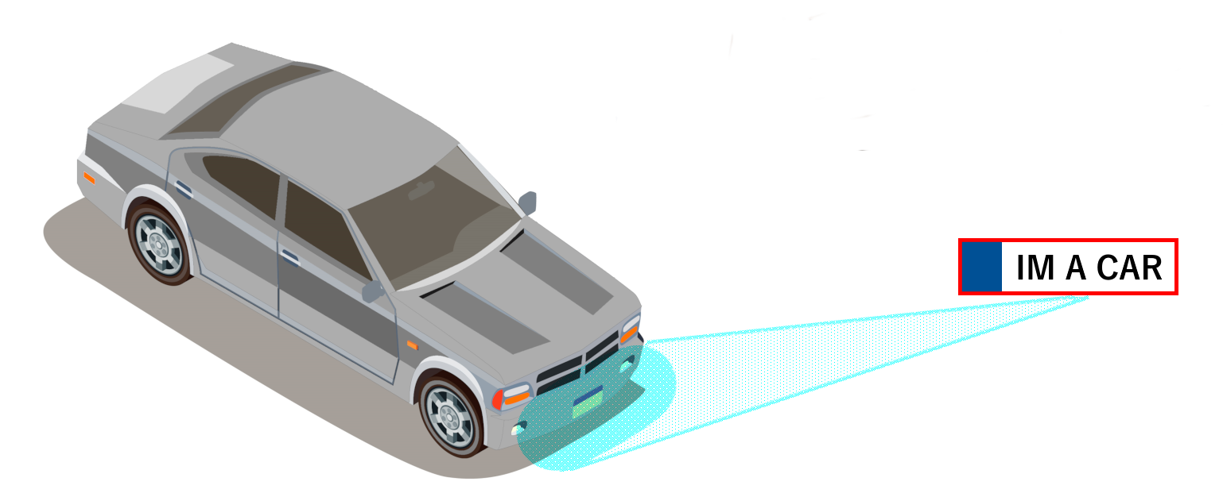
Relevance
Applicability:
automatic collection of money on toll roads;
traffic safety monitoring;
access control to closed areas.
Difficulties:
size, shape, color, font and placement of symbols variations;
different languages and special symbols;
video or photo qualities.
Standard steps for license plate recognition:
License plate detection (bounding box / segmentation).
Character segmentation.
Optical character recognition (OCR).
1

Slide 3
Related works
Nomeroff Net – open-source framework for license plates recognition.
License plate detection model based on YOLOv5 convolutional neural network;
Licence plate OCR model based on GRU modules.
2

Slide 4
Main goal
Goal: Develop the main components of the ALPR system: license plate detection model and multilingual license plate recognition model for the CIS countries.
Tasks:
Develop license plate detection model
Develop multilingual license plate recognition model for the CIS countries.
Perform a comparative analysis with Nomeroff Net approach and draw conclusions based on the results of experiments of the developed models.
3

Slide 5
Detection model
1
YOLO application: object detection, classification, semantic segmentation, object tracking, and pose estimation.
YOLOv5 improvements:
Adaptive anchor box selection process “autoanchor”.
Mosaic augmentation.
YOLOv8 improvements:
New structural convolution block.
Anchor-free detection system.
Corrected use of mosaic augmentation.
1. YOLO by Ultralytics. URL: https://github.com/ultralytics/ultralytics
4

Slide 6
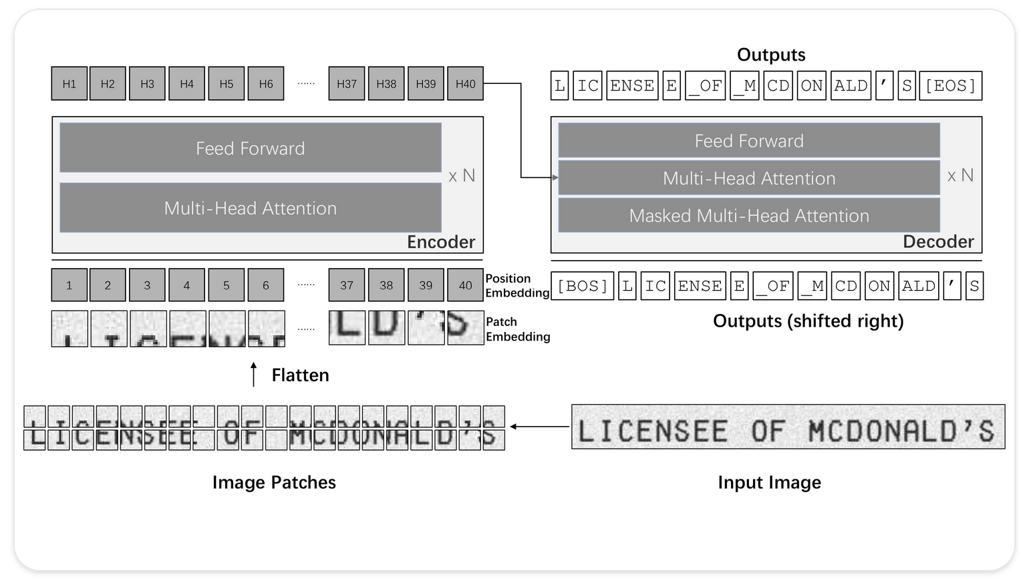
OCR model
1
TrOCR
Training: synthetic Wikipedia corpus of raw text images.
Encoder: visual transformer
DEiT;
BEiT.
Decoder: text transformer
MiniLM;
RoBERTa.
Pretrained versions:
First-stage.
Second-stage:
handwritten
printed
Fig. 1: The architecture of TrOCR, where an encoder-decoder model is designed with a pre-trained image Transformer as the encoder and a pre-trained text Transformer as the decoder.
1. Li, M., Lv, T., Chen, J., Cui, L., Lu, Y., Florencio, D., Zhang, C., Li, Z., Wei, F., 2021. Trocr: Transformer-based optical character recognition with pre-trained models. arXiv preprint arXiv:2109.10282 .
5

Slide 7
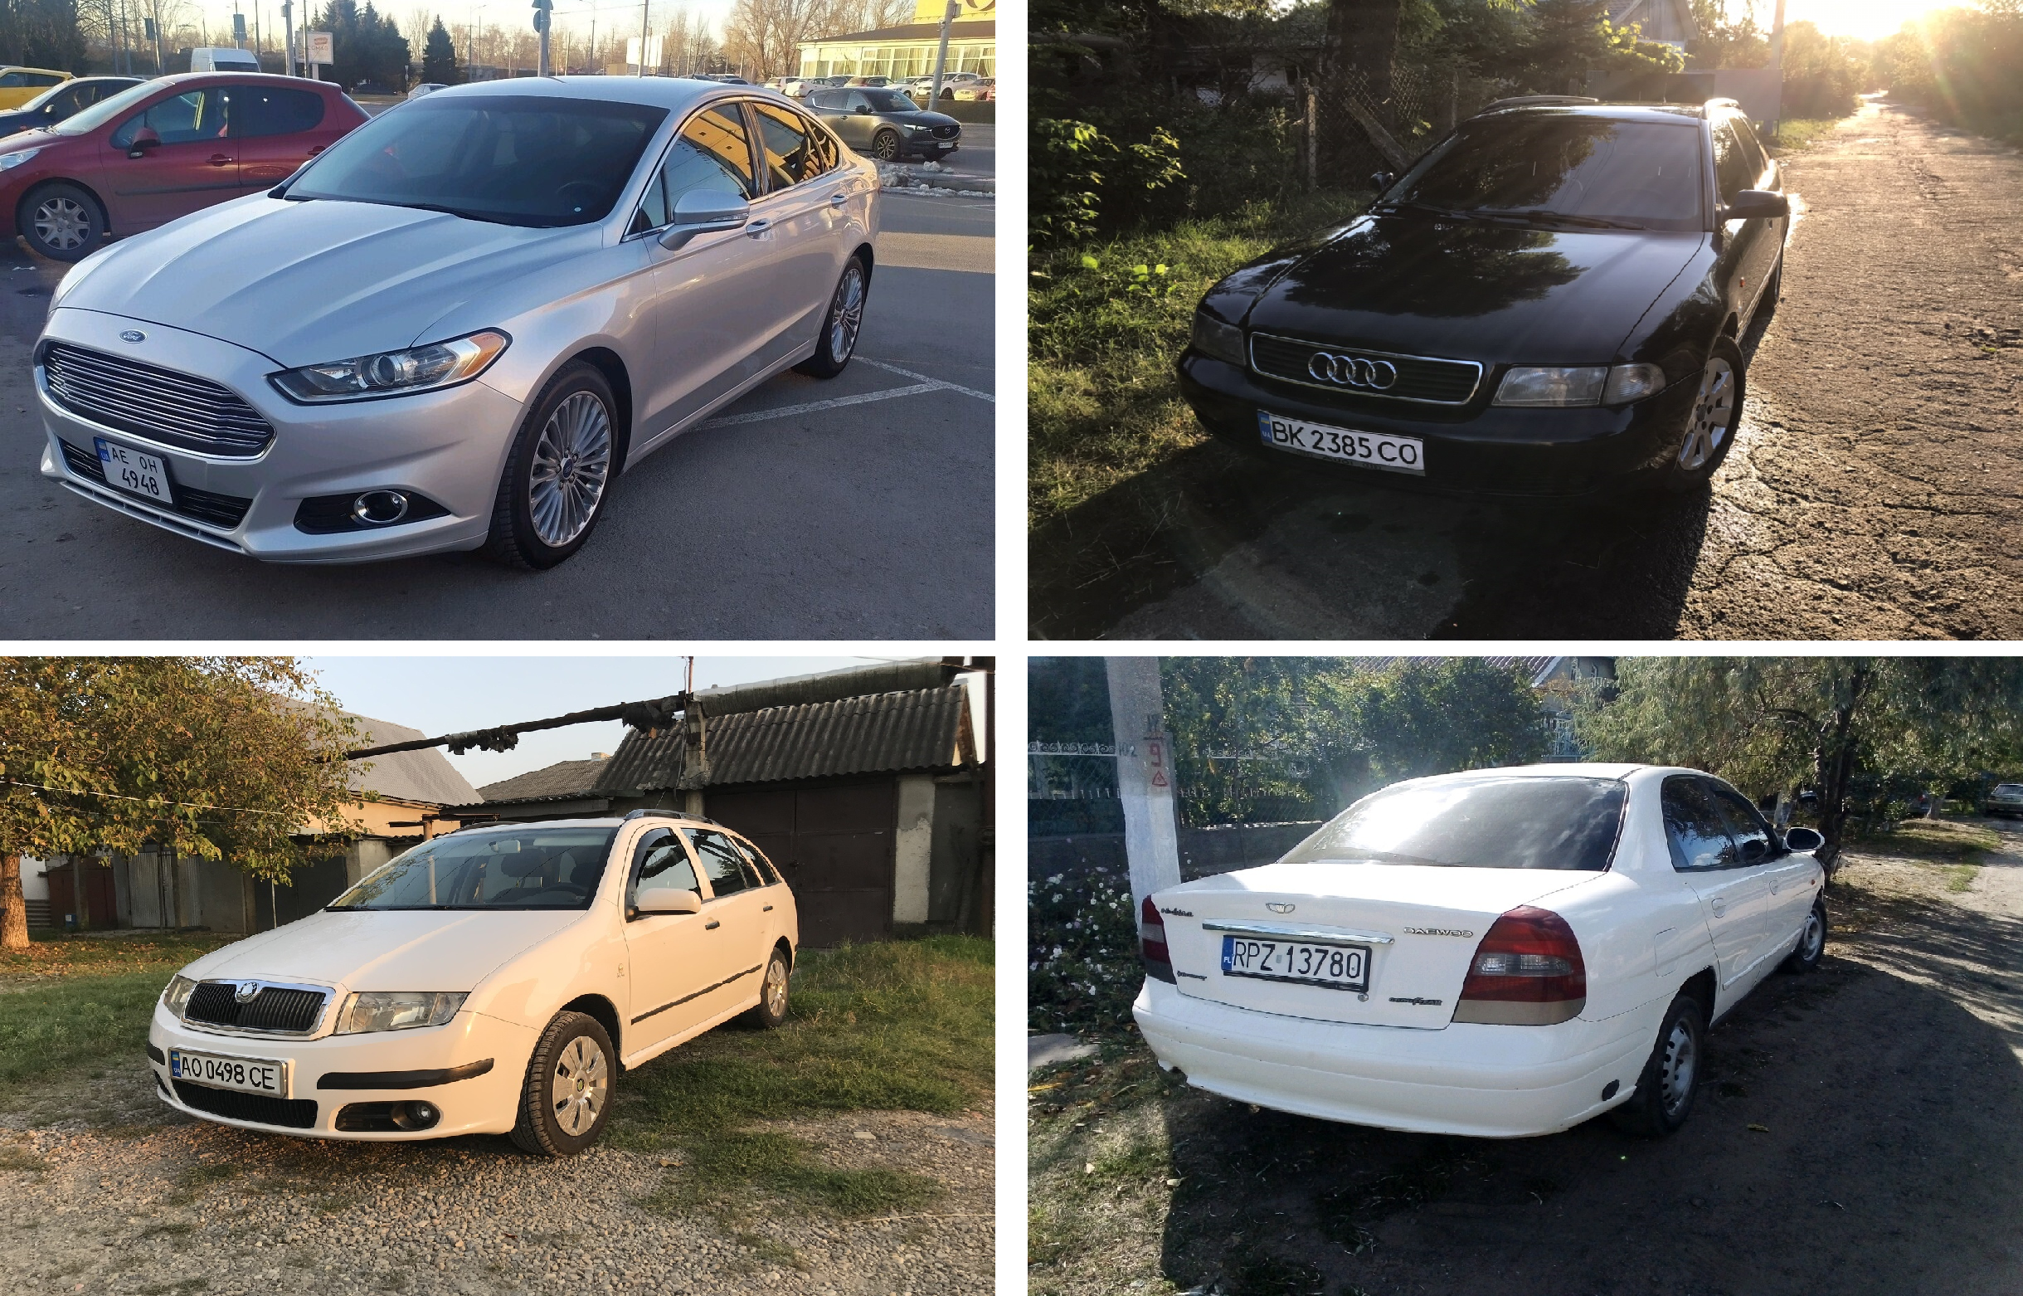
Data
License plate detection data (1/2)
The detection dataset has 11384 images.
Data split:
train: 7968 (70%)
validation: 1708 (15%)
test: 1708 (15%).
Preprocessing:
Image resizing: 640x640
Augmentation:
scaling;
color space adjustment;
mosaic transforms.
Fig. 1. Vehicles examples with license plates from Nomeroff Net dataset. Photos taken under different environments. In many samples, the camera viewpoint transforms the perspective projection of license plates in the image
6

Slide 8

Data
Optical character recognition data (2/2)
Preprocessing:
Image resizing:
TrOCR fine-tuning: 384x384
Scratch visual transformers: 224x224
Square operation (for some experiments)
Augmentation:
Random choice from next list:
random rotation (-10 to 10 degrees),
gaussian blurring,
image dilation,
image erosion,
downscaling,
underlining,
keeping the original image.
Table 1. Number of samples according to the split sets for each available license plate OCR dataset from Nomeroff Net.
Country | Short name | Train | Valid | Test
Kazakhstan | Kz | 8642 | 1001 | 279
Moldova | Md | 10531 | 789 | 849
Armenia | Am | 11524 | 565 | 620
Georgia | Ge | 24986 | 738 | 2777
Kyrgyzstan | Kg | 29204 | 1645 | 1068
ex USSR | Su | 35310 | 1874 | 1618
Europe | Eu | 42738 | 1359 | 1531
Russia | Ru | 49382 | 4893 | 2845
Ukraine | Ua | 121721 | 2146 | 2304
Fig. 1. License plates examples from Kazakhstan, Georgia, Armenia, and Kyrgyzstan. Each country has an original design, where the font, position and the order of characters differ
7

Slide 9

Metrics
Object detection metric:
$$mAP@50=\frac{1}{n}\sum_{k=1}^{n}{{AP}_{k}}, where TP if IoU>0.5$$
$$AP=\sum{(r_{n+1}−r_{n})p_{interp}(r_{n+1})}$$
$$p_{interp}\left(r_{n+1}\right)=\max_{\tilde{r}≥r_{n+1}}{p(\tilde{r})}$$
OCR metric:
$$CER=\frac{I+D+S}{N},$$
where $I$ num of insertions, $D$ is a number of deletions, $S$ is a number of substitutions, $N$ is a number of characters in the prediction.
(1)
(2)
(3)
(4)
8

Slide 10

Experiments setup
GPU: NVIDIA TITAN RTX (24GB of RAM)
Localization model:
Weights for YOLOv5/v8: pretrain MS COCO.
Model size: ‘s’ small, 7.2M parameters.
Batch size: 32.
Input image size: 640x640.
Epochs: 100.
OCR model:
TrOCR fine-tuning:
Model size:
base (${BEiT}_{base}$ 12 layers + ${RoBERTa}_{base}$ 6 last layers, 334M parameters), batch size: 4 .
large (${BEiT}_{large}$24 layers + ${RoBERTa}_{large}$ 12 layers, 558M parameters), batch size: 2.
Input image size: 384x384
Training: 1500 / 4000 steps
Scratch encoder-decoder transformer training.
Encoder: ViT
Decoder: enBERTc / deeppavlov-BERTc / geo-BERTc
Input image size: 224x224
Training: 9000 steps
9

Slide 11
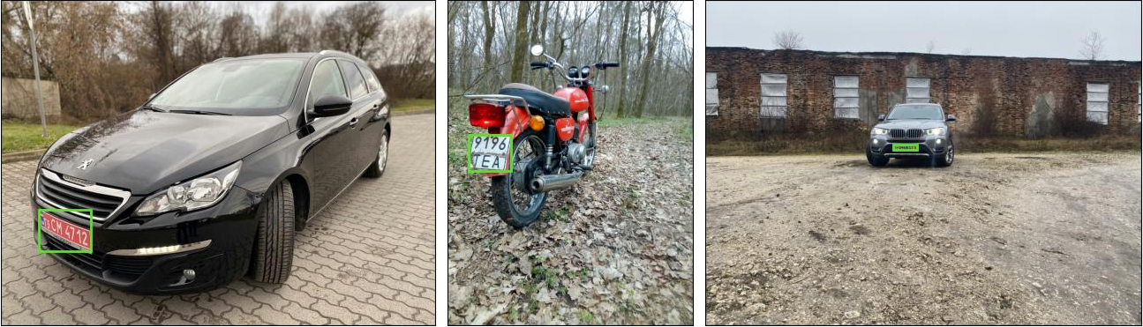
Experiments
License plate detection
Fig. 1. Examples of successful license plates detections of various vehicles by trained YOLOv8 model. Recognized license plate highlighted with a green bounding box.
 | mAP@50 | Inference time
YOLOv5 | 0.951 | 8.7ms
YOLOv8 | 0.981 | 3.3ms
Table 1. Results by mAP@50 metric of YOLO models fine-tuning for license plate localization task. The best result achieved on the test set after 100 epoch training is shown in bold.
10

Slide 12
Experiments
Optical character recognition. Fine-tuning on ‘Ru’ dataset (1/2)
Table 1. Testing results of TrOCR fine-tuning on license plate recognition task by CER metric for "Ru" dataset OCR experiments. The best result is shown in bold.
Method | Step num | Model size | Pretraining | Aug | Tune | CER
Nomeroff app |  |  |  |  |  | 0.00050
TrOCR | 1500 | base | stage1 |  |  | 0.00075
TrOCR | 1500 | base | printed |  |  | 0.00084
TrOCR | 1500 | base | stage1 | augmented |  | 0.00063
TrOCR | 4000 | base | stage1 | augmented |  | 0.00485
TrOCR | 1500 | base | stage1 |  | tuned | 0.00121
TrOCR | 1500 | large | stage1 |  |  | 0.00134
Table 2. Vision transformer encoder-decoder scratch testing results by CER metric for ”Ru” dataset OCR experiments
Method | Encoder | Decoder | Steps | Extra params | CER
Scratch | ViT224 | en-BERTc | 9000 | square,lower | 0.00472
Scratch | ViT224 | deepavlov-BERTc | 9000 |  | 0.00430
Scrath | ViT224 | geo-BERTc | 9000 |  | 0.04516
11

Slide 13
Experiments
Optical character recognition. Per country experiments (2/2)
Table 1. Results by CER metric on test data for other (Am, Eu, Kg, Kz, Su, Ge, Ua, Md) datasets OCR experiments. The best results are shown in bold
Country | Nomeroff app | TrOCR base-stage1, 1500 steps | TrOCR base-stage1, augmented, 1500 steps | TrOCR base-stage1, augmented, 1500 steps, square, lower
Kz | 0.00454 | 0.00499 | 0.00136 | 0.00181
Md | 0.00195 | 0.00019 | 0.00058 | 0.00039
Am | 0.00069 | 0.00069 | 0.00023 | 0.00069
Ge | 0.00119 | 0.00549 | 0.00281 | 0.00233
Kg | 0.00267 | 0.00069 | 0.00214 | 0.00253
Su | 0.00406 | 0.01094 | 0.00273 | 0.00361
Eu | 0.00576 | 0.01359 | 0.00490 | 0.00726
Ua | 0.00152 | 0.00211 | 0.00092 | 0.00211
12

Slide 14
Conclusion and future work
Conclusion.
The proposed model can be employed as the major element of intelligent infrastructure like toll fee collection, parking management, and traffic surveillance.
The powerful detection model shows a result of 0.983 for mAP@50 metric in the fine-tuning scenario while surpassing the baseline in terms of speed and performance.
TrOCR model fine-tuning showed the best result on 7 out of 9 datasets (Armenia, Kazakhstan, Ukraine, Moldova, ex-USSR, Kyrgyzstan, and Europe).
Future work:
Develop a full-fledged automatic license plate recognition (ALPR) system for the CIS countries.
Develop automatic OCR model selection for a specific country.
Develop an algorithm for normalizing perspective distortions of license plates.
Expand the database with additional data by collecting data via Internet requests - for example, from “platesmania.com” (containing more than 40k samples for each country in question).
13

Slide 15
Thanks for your attention

